Slide 1
IP ADDRESS

Slide 2
IP Address in Networking
IP Address is short for Internet Protocol Address.
It is a unique address assigned to each computing device in an IP network.
ISP assigns IP Address to all the devices present on its network.
Computing devices use IP Address to identify and communicate with other devices in the IP network.

Slide 3
Dotted decimal notation
Dotted decimal notation is a method of writing the 32 bit IP address in terms of 8 bit numbers separated by decimal point. The general form is
Valuel.VaIue2.Value3.Value4
192.168.25.1
In this each value is represented by decimal numbers 0 to 255. These numbers are called octets.

Slide 4
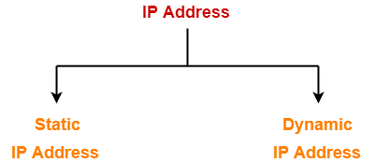
Types Of IP Address

Slide 5
Types Of IP Address
Static IP Address
Static IP Address is an IP Address that once assigned to a network element always remains the same.
They are configured manually.
Dynamic IP Address
Dynamic IP Address is a temporarily assigned IP Address to a network element.
It can be assigned to a different device if it is not in use.
DHCP or PPPoE assigns dynamic IP addresses.

Slide 6
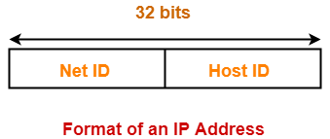
IP Address Format
IP Address is a 32 bit binary address written as 4 numbers separated by dots.
The 4 numbers are called as octets where each octet has 8 bits.
The octets are divided into 2 components- Net ID and Host ID.
Network ID represents the IP Address of the network and is used to identify the network.
Host ID represents the IP Address of the host and is used to identify the host within the network.

Slide 7
IP Address Example
00000001.10100000.00001010.11110000
(Binary Representation)
OR
1.160.10.240
(Decimal Representation)

Slide 8
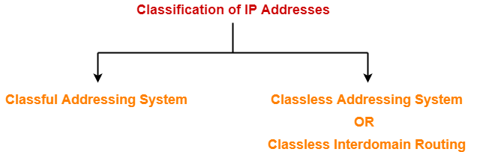
There are two systems in which IP Addresses are classified

Slide 9
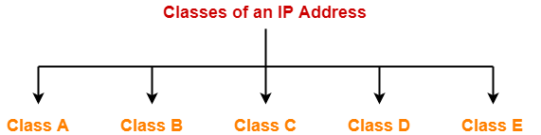
Classful Addressing
In Classful Addressing System, IP Addresses are organized into following 5 classes
Class A 00000001 to 01111111 i.e., 1 to 127.
Class B 10000000 to 10111111 i.e. 128 to 191.
Class C 11000000 to 11011111 i.e. 192 to 223.
Class D 11100000 to 11101111 i.e. 224 to 239.
Class E 11110000 to 11111111 i.e. 240 to 255.

Slide 10
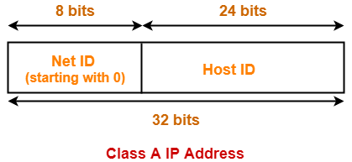
Class A
If the 32 bit binary address starts with a bit 0, then IP Address belongs to class A.
In class A IP Address,
The first 8 bits are used for the Network ID.
The remaining 24 bits are used for the Host ID.

Slide 11
Total Number Of IP Addresses-
Total number of IP Addresses available in class A
Numbers possible due to remaining available 31 bits= 2³¹
Total Number Of Networks-
Total number of networks available in class A
Numbers possible due to remaining available 7 bits in the Net ID – 2
= 2⁷ – 2
= 126
Total Number Of Hosts-
Total number of hosts that can be configured in class A
= Numbers possible due to available 24 bits in the Host ID – 2
= 2²⁴ – 2
Range Of 1st Octet-
We have-
Minimum value of 1st octet = 00000000 = 0
Maximum value of 1st octet = 01111111 = 127
From here,
Range of 1st octet = [0, 127]
But 2 networks are reserved and unused.
So, Range of 1st octet = [1, 126]
Use-
Class A is used by organizations requiring very large size networks like NASA, Pentagon etc.
2^24 – 2 = 16,777,214 host ID

Slide 12
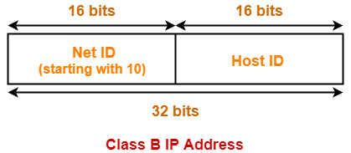
Class B
If the 32 bit binary address starts with bits 10, then IP Address belongs to class B.
In class B IP Address,
The first 16 bits are used for the Network ID.
The remaining 16 bits are used for the Host ID.

Slide 13
Total Number Of IP Addresses-
Total number of IP Addresses available in class B
= Numbers possible due to remaining available 30 bits
= 2³⁰
Total Number Of Networks-
Total number of networks available in class B
= Numbers possible due to remaining available 14 bits in the Net ID
= 2¹⁴
Total Number Of Hosts-
Total number of hosts that can be configured in class B
= Numbers possible due to available 16 bits in the Host ID – 2
= 2¹⁶ – 2
Range Of 1st Octet-
We have-
Minimum value of 1st octet = 10000000 = 128
Maximum value of 1st octet = 10111111 = 191
So, Range of 1st octet = [128, 191]
Use-
Class B is used by organizations requiring medium size networks like IRCTC, banks etc.
2^14 = 16384 network address
2^16 – 2 = 65534 host address

Slide 14
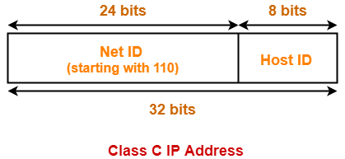
Class C
If the 32 bit binary address starts with bits 110, then IP Address belongs to class C.
In class C IP Address,
The first 24 bits are used for the Network ID.
The remaining 8 bits are used for the Host ID.

Slide 15
Total Number Of IP Addresses-
Total number of IP Addresses available in class C
= Numbers possible due to remaining available 29 bits
= 2²⁹
Total Number Of Networks-
Total number of networks available in class C
= Numbers possible due to remaining available 21 bits in the Net ID
= 2²¹
Total Number Of Hosts-
Total number of hosts that can be configured in class C
= Numbers possible due to available 8 bits in the Host ID – 2
= 2⁸ – 2
Range Of 1st Octet-
We have-
Minimum value of 1st octet = 11000000 = 192
Maximum value of 1st octet = 110111111 = 223
So, Range of 1st octet = [192, 223]
Use-
Class C is used by organizations requiring small to medium size networks.
For example- engineering colleges, small universities, small offices etc.
2^21 = 2097152 network address
2^8 – 2 = 254 host address

Slide 16
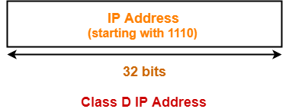
Class D
If the 32 bit binary address starts with bits 1110, then IP Address belongs to class D.
Class D is not divided into Network ID and Host ID.

Slide 17
Total Number Of IP Addresses-
Total number of IP Addresses available in class D
= Numbers possible due to remaining available 28 bits
= 2²⁸
Range Of 1st Octet-
We have-
Minimum value of 1st octet = 11100000 = 224
Maximum value of 1st octet = 11101111 = 239
So, Range of 1st octet = [224, 239]
Use-
Class D is reserved for multicasting.
In multicasting, there is no need to extract host address from the IP Address.
This is because data is not destined for a particular host.

Slide 18
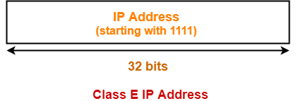
Class E
If the 32 bit binary address starts with bits 1111, then IP Address belongs to class E.
Class E is not divided into Network ID and Host ID.

Slide 19
Total Number Of IP Addresses-
Total number of IP Addresses available in class E
= Numbers possible due to remaining available 28 bits
= 2²⁸
Range Of 1st Octet-
We have-
Minimum value of 1st octet = 11110000 = 240
Maximum value of 1st octet = 11111111 = 255
So, Range of 1st octet = [240, 255]
Use-
Class E is reserved for future or experimental purposes.

Slide 20
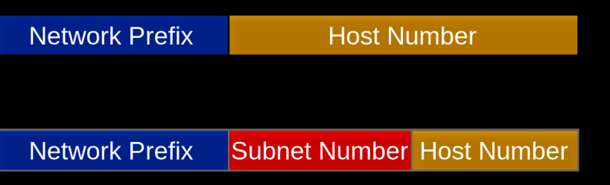
Subnet mask
In a 32 bit IP address, one portion contains network id and other portion contains host Id.
So it is necessary to distinguish both addresses.
Subnet mask is a 32 bit binary numbers Used to find out the network address from the IP address.

Slide 21
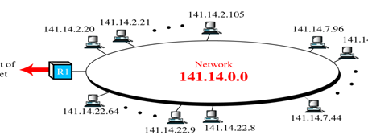
Subnets can be freely assigned within the organization
• Internally, subnets are treated as separate networks
• Subnet structure is not visible outside the organization

Slide 22
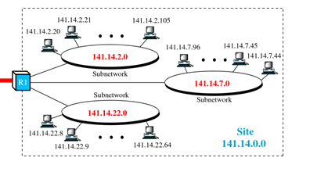

Slide 23
Class A - 255.0.0.0
or 11111111 .00000000.00000000. 00000000
Class B - 255.255.0.0
Or
11111111 . 11111111. 0000000 . 00000000
Class C - 255.255.255.0
or
11111111 .11111111.11111111. 00000000

Slide 24
Example - Consider a class C address
lP → 192.168.1.152
mask → 255.255.255.0
IP AND MASK in Binary Format
11000000 10101000 00000001 10011000
11111111 11111111 11111111 00000000
--------------------------------------------------------------------------------------------
11000000 10101000 00000001 00000000
---------------------------------------------------------------------------------------------
Network Id → 192.168.1.0
Generally IP address and its mask are written as IP address / mask
Mask can be 8 for A class, 16 for B class and 24 for C class.

